Slide 1
Views on Software Testing Principles
Created by: PARUL SONI
6 April 2021

Slide 2
Contents
Importance of quality in a fast-paced delivery environment
What is shifting left
Pros and Cons of shifting left quality
Exploratory testing vs automated testing
Synergizing Automated and Exploratory testing
Checklists for an efficient automation framework
Share any experience where you have driven quality process improvements

Slide 3
Importance of quality in a fast-paced delivery environment
In a world where businesses not only have to become software companies to compete, but deliver higher quality software to market faster. Testing needs to be as fast and as dynamic as our agile development processes.
For this Shift-left testing approach in Agile and DevOps with Automation (Web and API) in testing using CI/CD can be used for delivering high quality software to market on time.

Slide 4
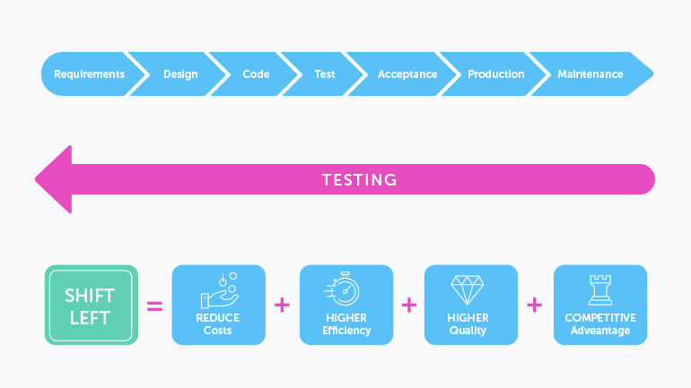
What is shifting left
Shift Left is a practice intended to find and prevent defects early in the software delivery process. The idea is to improve quality by moving tasks to the left as early in the lifecycle as possible. Shift Left testing means testing earlier in the software development process.
Shift-left testing activities include:
Testers helping developers implement unit testing
Planning, creating, and automating integration test cases
Planning, creating, and employing virtualized services at every stage and component level
Gathering, prioritizing, and processing feedback

Slide 5
Pros and Cons of shifting left quality
Pros | Cons
Lower the cost of testing & development | Approach not so easy to implement
Increased test coverage since more tests can be run in the same amount of time | Requires all developers to put an accent on testing as well, which causes a bit of an overhead
Reduced human error rate
Reducing issues in production that users may encounter
Increased product quality and efficiency
Find defects earlier, fix them quickly
Reduced time required to fix the defects

Slide 6
Exploratory testing vs automated testing
Exploratory Testing
Exploratory testing is the process of learning the product, designing test cases, executing test cases and interpreting the test results at the same time. It is a method that requires the tester to think critically through the entire process, making decisions based off factors such as the test scope, charter, and goals. Hence exploratory testing, by definition, cannot be automated.
Exploratory testing, relies on the tester’s skill, experience, and intuition to examine an application in a structured way, trying things that the tester believes may uncover weaknesses or limitations in the application.
This is done by exploring a software application and testing it without any predefined test cases.
The benefit of exploratory testing is that it allows a human mind to draw insights from a test that might otherwise be missed by test automation.
Exploratory testing cannot be automated as it requires human intervention.
Automated Testing
Automated Testing is testing software by creating test cases and writing scenarios using automated testing scripts.
For Automation testing many times requirements are focused strictly on business functionality, and don’t look beyond that to other parts of an application.
The script can be run multiple times reducing human effort.
Automated testing reduces human errors that can happen while manual testing.
Automation provides more free time, inhibits Human Interaction.
70% faster than the manual testing or exploratory testing.
Wider test coverage of application features.
Results are accurate and consistent.
Saves time and cost.
Increases efficiency.

Slide 7
Synergizing Automated and Exploratory testing
Though it is difficult to create automated exploratory test cases, but, with good documentation or an automated way of recording explorations, exploratory tests can be easily converted to manual or automated tests that can be used as regression tests.
At the same time, automated tests can provide good exploratory testers hints on future explorations. If an automated test fails, that often represents a regression that could affect other parts of the application. Even when automated tests succeed, they can suggest areas for further exploration.
Some exploratory testing recording tools available in market for exploratory testing are:-
Exploratory Testing Chrome Extension
Tricentis Exploratory Testing for Jira
JIRA Capture

Slide 8
Checklists for an efficient automation framework
Finding the right automation platform – e.g. selenium for web testing, Appium for mobile testing
Using proper design patterns. Eg: using page object model
Designing FW with keeping in mind the end result of automation.
No Code Duplication
Modularizing the code and keeping it simple. eg:- writing small functions performing particular actions only.
Code only for immediate requirements. This will minimize code redundancy.
Using proper coding standards.
Proper documentation, comments.
Using consistent naming conventions.

Slide 9
Share any experience where you have driven quality process improvements
Worked on a POC for automating process of pdf document verification using Microsoft Azure Form recognizer tool and Apache PDFBox library. This considerably reduced manual effort for each document taking 10 days time manually, to testing 1000s of pdf documents with accuracy in a day.
Worked on a POC on using Karate API automation FW for faster testing of APIs. This does not require lot of coding and can reduce time for creating automated test cases.
In my recent project the writing of test cases (in HP QC ALM) and tracking defects(JIRA Xray) was done using separate tools. I advised my team to incorporate test cases and defects both in JIRA as it would be easier to track defects and test cases and link them in JIRA.
Also the development team was from separate vendor where they were having no access to JIRA tool which was causing issue in assigning defects to Vendor. We had to create defects again for developers in separate doc and send them via email and then put it in JIRA as well. I suggested on providing the JIRA access to vendor as well because it was reducing our productivity.
The Development team was deploying their code in Dev and QA testing environment at the same time and the deployment was happening with new bugs during anytime of the day. This was causing regression. A proper code management was not done and this was causing issues. I suggested to deploy code during fixed time of day and QA environment to be separated with dev environment.

